Slide 1

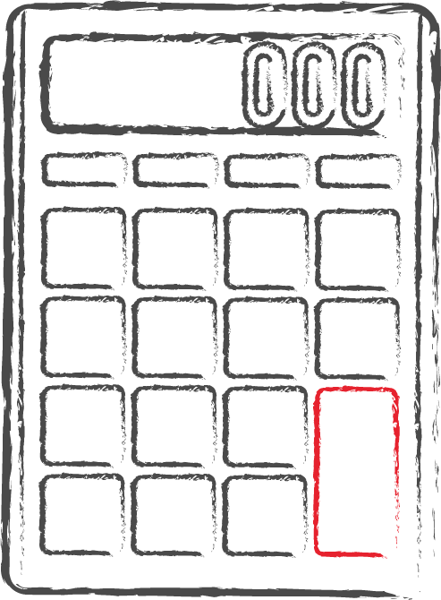

Application of Engineering Mathematics in
- CSE -
Presented by-
MD. Sazzadul Islam Shaon
ID : 0242310005101028
Section : 64_B

Slide 2

Course Details
Tutor Details
Course Title : Engineering Mathematics
Course Code : MAT 211
Name : Noor Mohammad
Lecturer
Department of CSE

Slide 3
Table of contents
01
02
Power of Engineering Mathematics in CSE
Game Development, Animation, Graphics
03
04
Algorithm Design & Complexity analysis
Conclusion

Slide 4

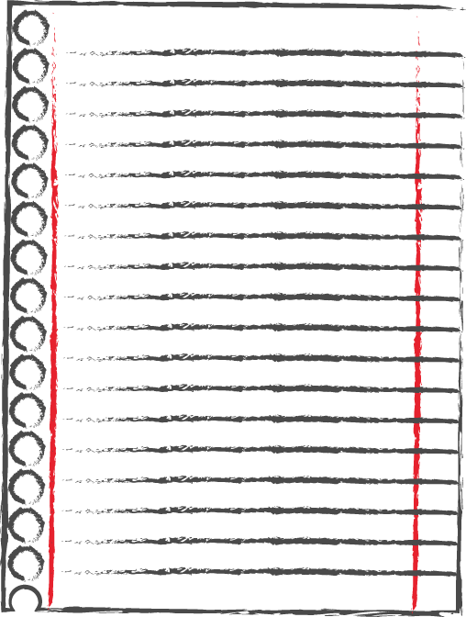
Engineering Mathematics
Engineering Mathematics is the mathematical methods and techniques that come in handy to solve engineering problems. This includes things like calculus, linear algebra, statistics, and more, applied to practical engineering situations.

Slide 5
01
Power of Engineering Mathematics in CSE
Game Development
Algorithm Design
Complexity analysis
Simulating Dynamic System
Computer Graphics
Artificial Intelligence
Machine Learning

Slide 6

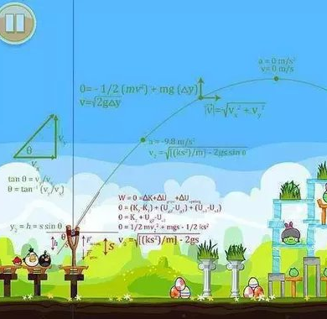
02
Calculus in Game Development
Physics Simulation
Calculus helps model real-world physics like motion, gravity, and collision detection, creating realistic and dynamic game environments
Animation
Use derivatives to animate smooth movement and transitions for game characters and objects.
Optimization
Calculus helps optimize game performance by finding the most efficient ways to render graphics, calculate AI behavior, and manage resources.

Slide 7
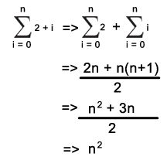
03
Algorithm Design & Complexity analysis
Algorithm Design
We use mathematical concepts like logic, functions, and recursion to design efficient algorithms, the step-by-step instructions computers follow to solve problems.
Complexity Analysis
Calculus helps analyze an algorithm's complexity, which measures how efficiently it uses resources (like time and memory) with increasing input size. (e.g., Big O notation)

Slide 8
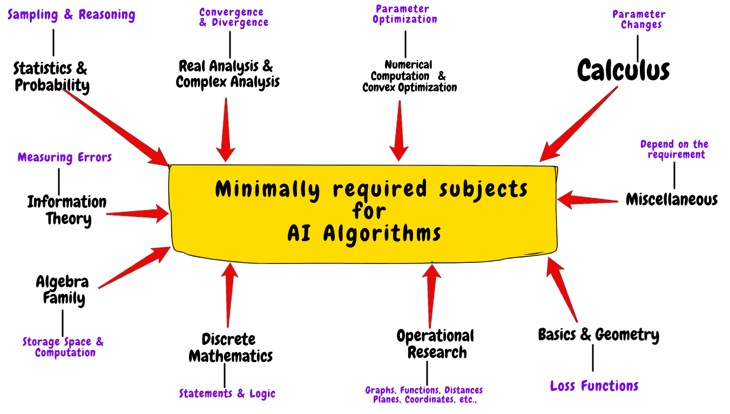
AI and Machine Learning
Artificial Intelligence
Many algorithm of Artificial Intelligence heavily depends on Calculus and Differential equations.
Machine Learning
Machine Learning you deal with a lot of statistics, data and probability and neither of them exists without calculus.

Slide 9
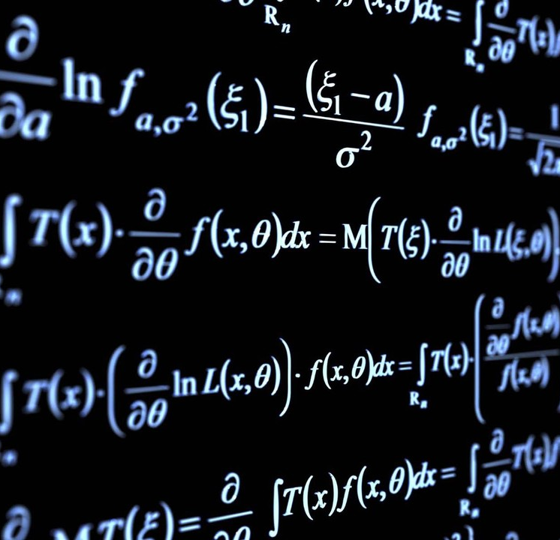
04
Conclusion
Engineering Mathematics provides a powerful toolkit for Computer Scientists.
From crafting captivating games to designing efficient algorithms, math is instrumental in various CSE fields.
A strong foundation in math equips us to tackle complex problems, optimize software, and create innovative technological solutions.

Slide 10
Thank
You!

